Slide 1







LAPTOP PRICE PREDICTION
BY -
ABHINAV 220619
AYUSH GURJAR 220466
JATIN SINGH 220347
HIMANSHU 220593
VISHAL YADAV 220621

Slide 2


OVERVIEW
This project focuses on predicting laptop prices using a robust machine learning pipeline. By leveraging real-world data from Flipkart, the methodology integrates data collection, preprocessing, exploratory analysis, and model implementation to deliver accurate predictions. The final deployment involves a user-friendly Flask-based web application for real-time price estimation. This presentation outlines each phase of the methodology and its contribution to achieving the project’s goals.

Slide 3
DATA COLLECTION: SCRAPING FROM FLIPKART
Source:
Flipkart, one of India's largest and most popular e-commerce platforms.
Offers a wide variety of laptops with diverse configurations and price points.
Ensures that the dataset reflects real-world market trends and scenarios.
Tools Used:
Python-based web scraping tools such as BeautifulSoup and Selenium.
These tools were employed to automate the extraction of detailed information from Flipkart's laptop listings.
Extracted Features:
Brand, Model, Processor type and Generation, RAM size, Storage type and Capacity, Operating System, User Ratings, Reviews, and Prices

Slide 4
DATA PREPROCESSING
The raw data extracted from Flipkart required extensive preprocessing to prepare it for analysis and model training. This involved several key steps:
Handling Missing Values
Removing Duplicates
Data Transformation
Rows with missing values in essential features, such as price or processor details, were removed. This ensures that the model only learns from complete and reliable data points.
Duplicate entries were identified and eliminated to avoid bias in the data. Duplicate entries can skew model training, leading to inaccurate predictions.
Categorical features, such as brand, color, and operating system, were converted into numerical values using one-hot encoding or label encoding.
Standardization
Outlier Detection
Features with varying scales, like weight and screen size, were standardized to a common scale. This ensures that all features contribute equally to the model's learning process.
Extreme values, or outliers, in features like price were detected and either corrected or excluded. Outliers can negatively impact model performance and distort predictions. This step ensures model reliability by eliminating these extreme values.

Slide 5
EXPLORATORY DATA ANALYSIS
This analysis involved several techniques:
Correlation Analysis
The EDA focused on analyzing the correlations between different features and their impact on laptop price. Key insights were gained from examining correlations between RAM, processor generation, SSD capacity, and price, revealing the significant predictors influencing laptop pricing.
Visualization
Data visualization tools were employed to create various charts, including histograms, box plots, and scatter plots. These visualizations helped visualize the distribution of price, understand the relationships between features, and identify potential patterns or trends influencing pricing.
Insights
The EDA yielded actionable insights into the factors driving laptop prices. For instance, it was observed that higher RAM, newer processor generations, and larger SSD capacities generally result in higher prices. This analysis provided valuable guidance for feature selection and model development.

Slide 6
MODEL IMPLEMENTATION: PREDICTING LAPTOP PRICES WITH MACHINE LEARNING
Algorithm
Lasso Regression
R2 Score: 0.927538453857948
KNN Regression
R2 Score: 0.9365686113076417
Decision Tree
R2 Score: 0.9509498583743491
Support Vector Regression
R2 Score: 0.9161009549478853
Random Forest
R2 Score: 0.9744555921581622

Slide 7
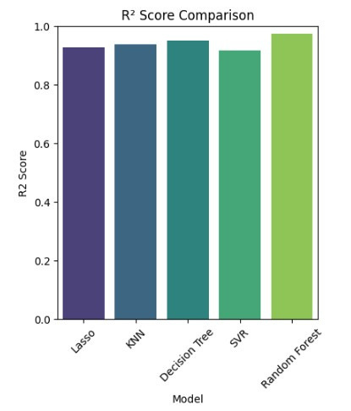
MODEL EVALUATION: CHOOSING THE BEST ALGORITHM
The performance of each algorithm was rigorously evaluated using standard machine learning metrics. R-squared (R²) measured the proportion of variance explained by the model, while Mean Absolute Error (MAE) assessed the average deviation of predictions from actual prices.
Through this comprehensive evaluation, Random Forest emerged as the best-performing algorithm due to its ability to handle non-linear relationships and complex feature interactions effectively. It achieved the highest R-squared value and the lowest MAE, indicating its superior predictive accuracy and reliability.

Slide 8



DEPLOYMENT: MAKING THE MODEL ACCESSIBLE
To make the trained Random Forest model accessible to users, a web application was developed using Flask. This application provides a user-friendly interface for inputting laptop specifications and receiving real-time price predictions.
1.
2.
3.
Interface Design
Prediction Engine
Testing and Validation
The application features a user-friendly interface with input fields for key laptop specifications, such as RAM, processor, brand, and storage. Users can easily enter these details and receive a prediction based on the trained model.
The trained Random Forest model was integrated into the web application, enabling it to provide real-time price predictions based on user inputs. When a user enters their desired specifications, the model processes this data and generates a price prediction, which is then displayed to the user.
The application was rigorously tested and validated using sample inputs to ensure its accuracy and usability. This included comparing predictions generated by the application with actual prices of laptops from Flipkart, confirming the model's reliability and the application's effectiveness.

Slide 9
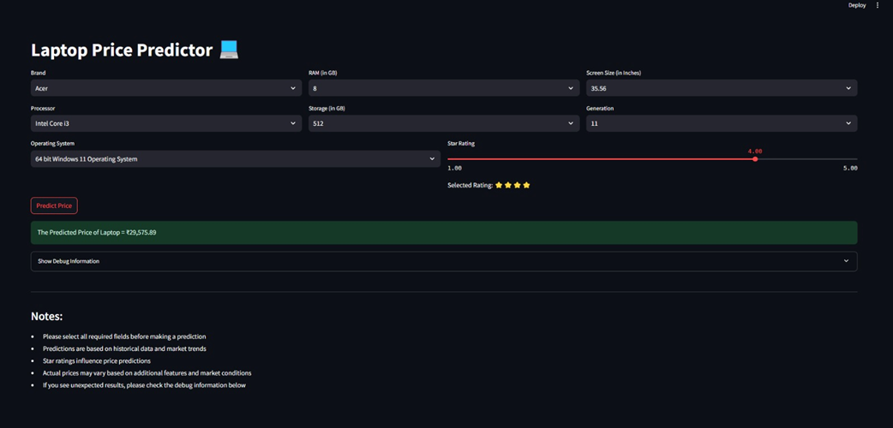
USER INTERFACE
ACTUAL VALUE –
PREDICTED VALUE –

Slide 10
THANK YOU

